Slide 1
Submitted by: 1.Shivakant Dubey(2sd13cs107)
2.Sanu Prince(2sd13cs102)
Presentation On:
Smart library Management system
(6th Semester)
Under Guidance of: Prof. Mayur Patil

Slide 2
Index
Description.
Components.
Justification of components.
Architecture.
Features supported.
Applications of project.
Limitations of project.
Future Scope.
References.

Slide 3
Description:
The world is drenched in the internet and now the Internet of Things is also gaining a lot of attention. But the application of the internet technology in library management is at its infancy. In Smart Library Management System everyone has a smartphone and is connected to the internet, the doctrine of building a connected library system where the user can utilize his mobile phone to connect to the library system and also find the position of the book through a local positioning system would prove to be very useful. The aim of the concept in this paper is to build a “Smart Library System” with facilities to issue, return and even locate the book using an authenticated smart phone.
Notes:
Reduces Staff stress and increases management efficiency
Can help prevent theft
Fastest, easiest, most efficient way to track, locate & manage library materials
Efficient Book circulation & management
Library inventory tracking in minutes instead of hours
Multiple books can be read simultaneously
Unique ID of the RFID tag prevents counterfeiting
Automated material handling
Faster Check-in / Check-out
Longevity of Tags – Shelf life equivalent to the Book

Slide 4
List of components with approx cost:
SI No. | Components | Quantity | Cost (INR)
1. | RFID Scanner | 1 | 275
2. | LCD Display | 1 | 110
3. | RFID Cards (TOKEN) | 8 | 200
4. | Arduino Board Uno | 1 | 450
5. | ESP8266 WIFI Module | 1 | 230
6. | LED Bulbs | 4 | 40

Slide 5
Justification of components:
Components | Similar Components | Justification
1. RFID Scanner | Barcode Reader | Barcode Scanner is costly compare to RFID and cover the area which is under its range
2.LCD Display | CRT | CRTs are bigger and bulkier than an LCD, they consume more power and are prone to screen flicker
3.RFID Cards (TOKEN) | Barcode | Don’t store Data
4.Arduino Board Uno | Microcontroller-IC | Bigger and bulky, not support so much function
5.ESP8266 WIFI Module | Microchip MRF24WB0MA | Simple to configure and use
6.LED Bulbs | Simple bulbs | Connection issue and glowing sense

Slide 6
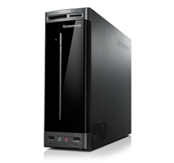

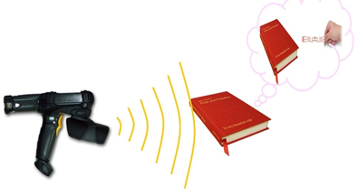
Architecture: Module-1
Database Server
RFID Tag for Insertion
Handheld Reader for verification & Issuing Purpose
Notes:
Basic RFID implementation for Small and Medium Libraries

Slide 7
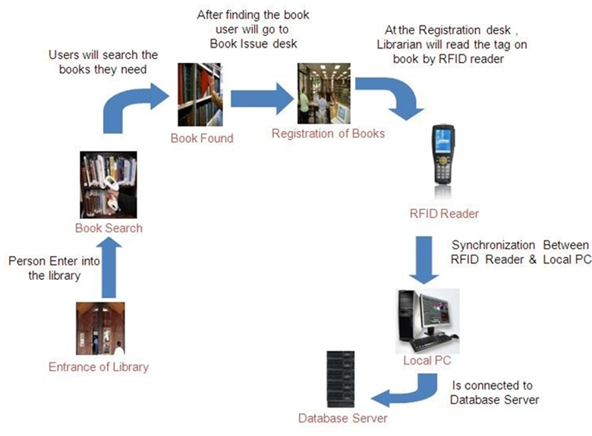
Architecture: Module-1 Process Flow
SMART
LBMS

Slide 8

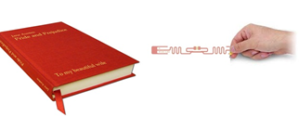
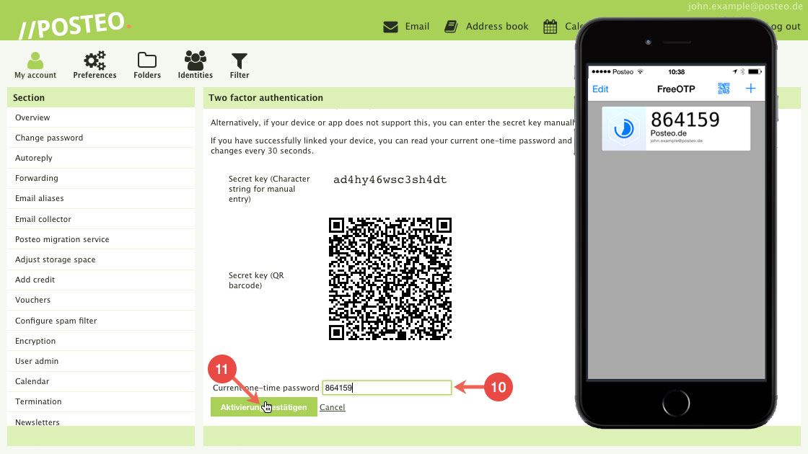

Architecture: Module-2
Database Server
RFID Tag for Insertion
Handheld Reader for verification & Issuing

Slide 9
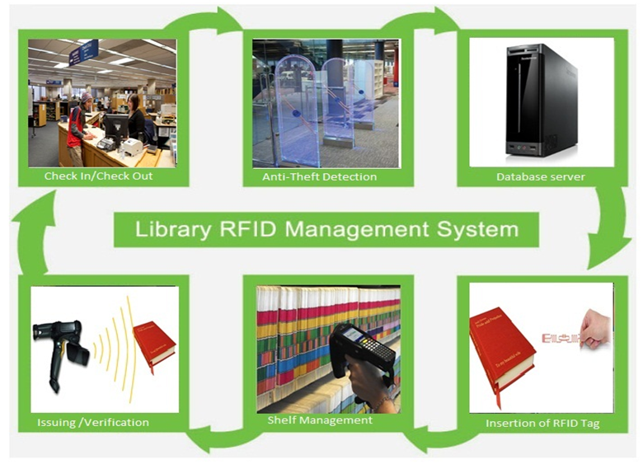
Architecture: Module-2 Process Flow
Notes:
Advanced RFID based Library Management System for Medium sized Libraries

Slide 10


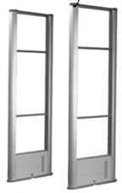
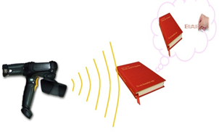
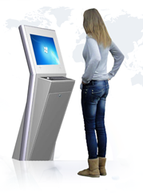
Architecture: Module-3
Database Server
RFID Tag for Insertion
Handheld Reader for verification & Issuing
Anti-Theft Detection Door

Slide 11
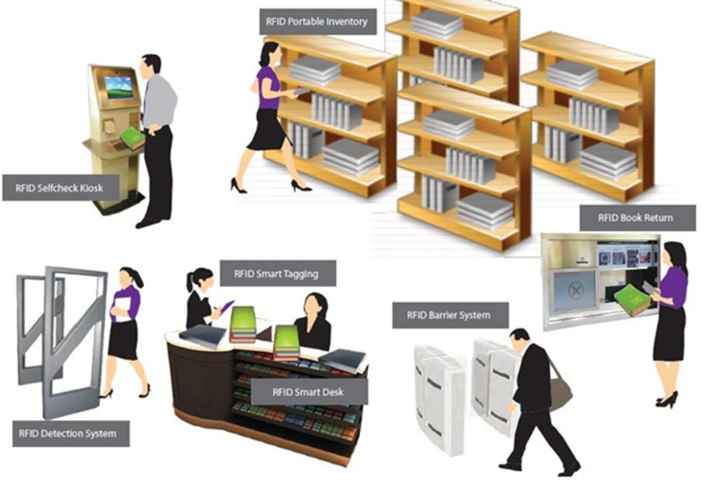
Architecture: Module-3 Process Flow
Notes:
Advanced RFID based Smart LBMS with Security and Surveillance for Modern Large size Libraries

Slide 12
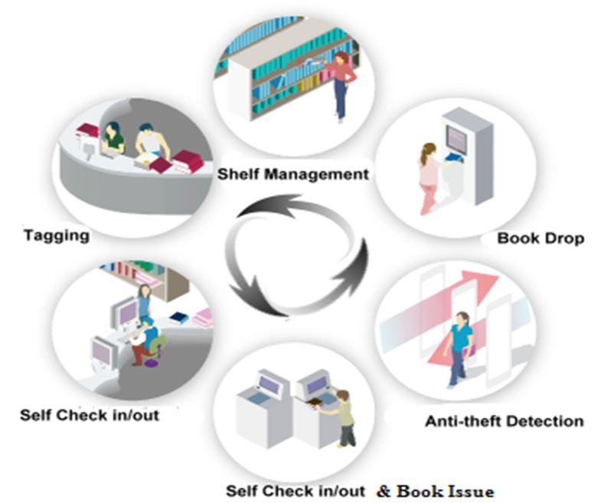
Architecture: Overall Module

Slide 13
Features supported IA-1:
RFID tag reading by RFID scanner and storing of data in cloud.

Slide 14

Features supported IA-2:
Checking the details of book present in a Library using Android App( MIT App inventor).
Scanning the Barcode of the Book.
Searching details using ISBN (International Standard Book Number).
Using Amazon API for the Information of books.

Slide 15
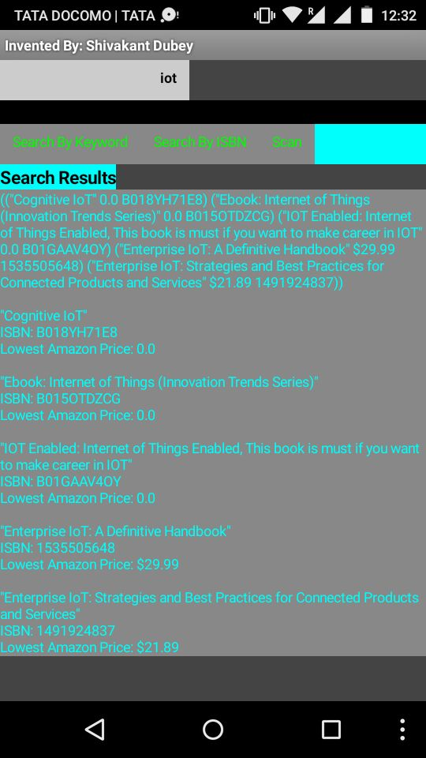
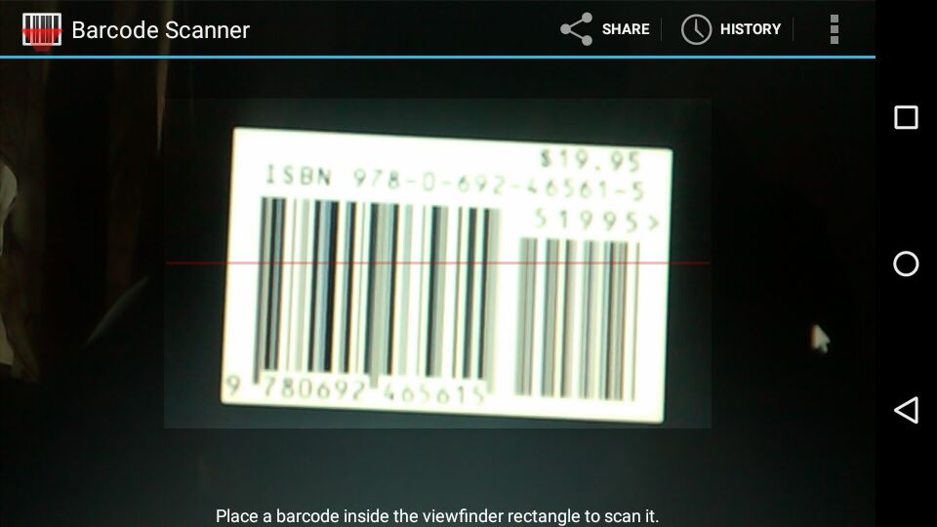
Android App attached with Amazon Web API and ISBN( Searching future ).

Slide 16
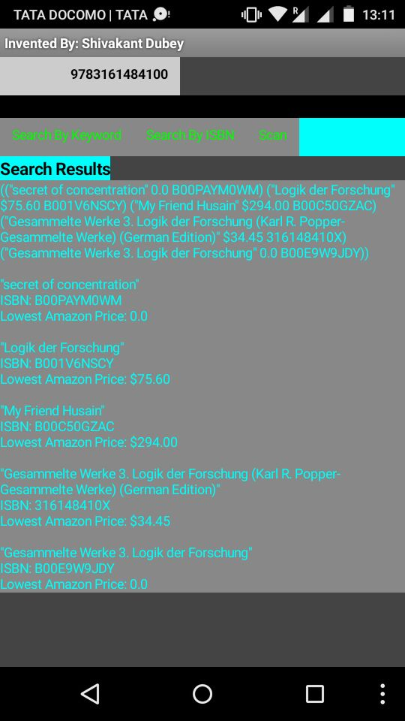
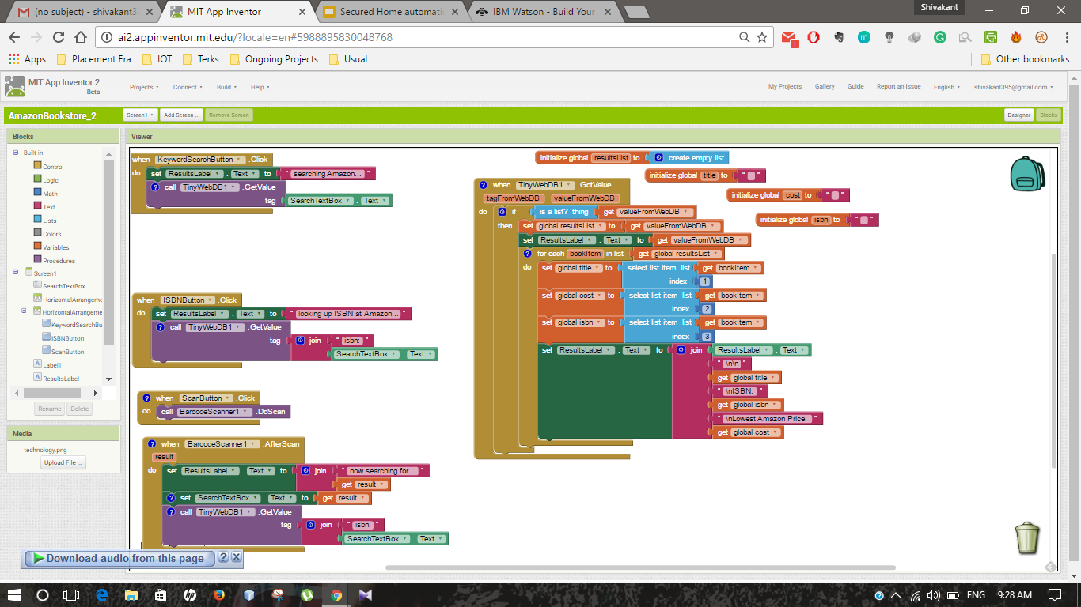

Slide 17
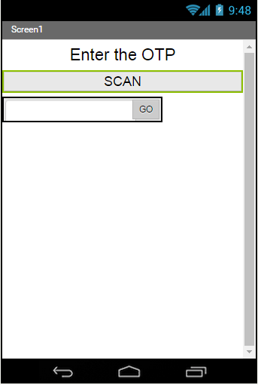
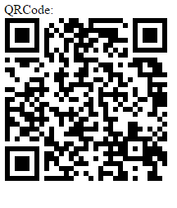
Get an OTP or (SMS) on mobile by scanning QR-Code by an App and get authorization to access system.

Slide 18
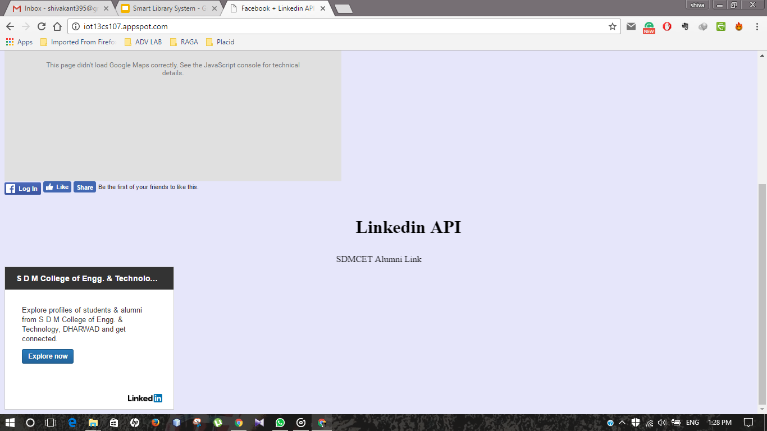
Facebook api and LinkedIn Connection (SDMCET Alumni ) by using Codenvy.

Slide 19
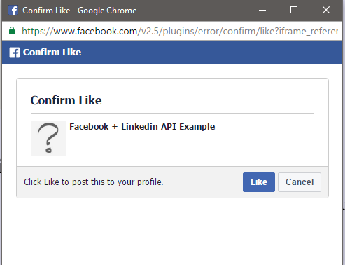
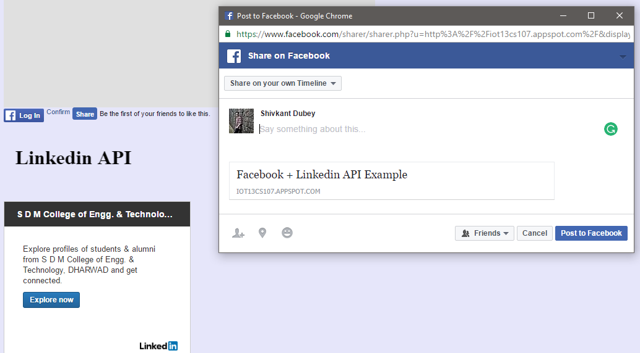

Slide 20
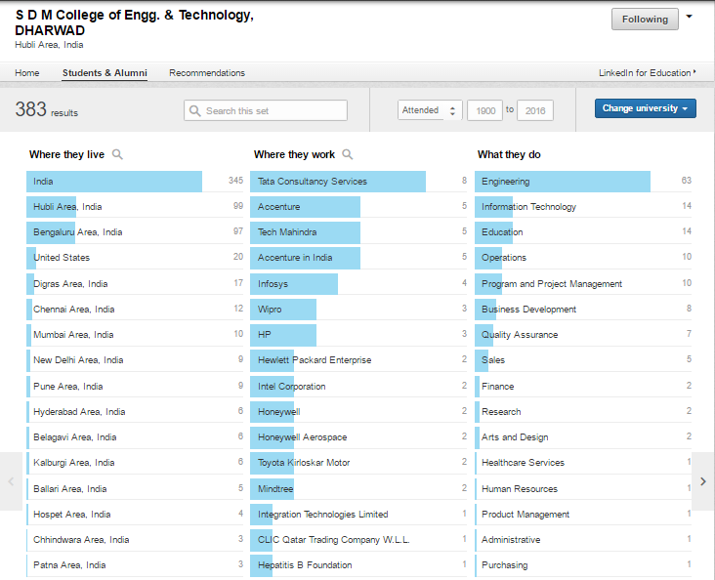
SDMCET Alumni LinkedIn Connection.

Slide 21
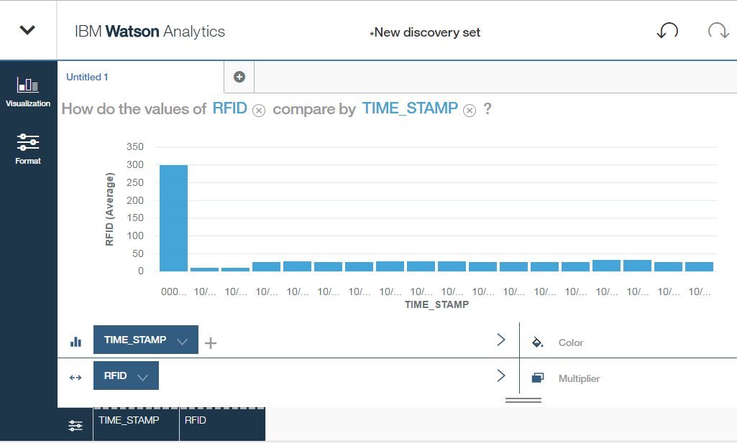
RFID tag reading by RFID scanner and storing of data in cloud and Data analytics.

Slide 22
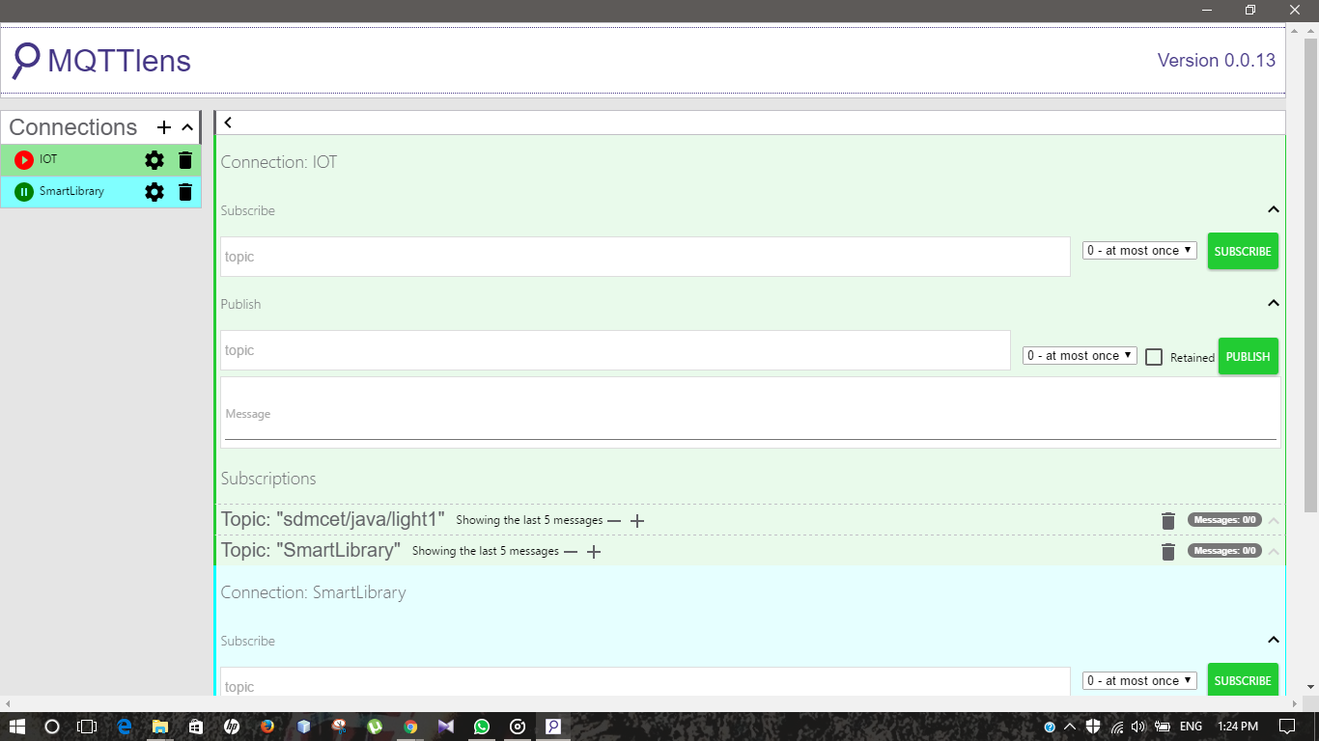
Controlling of System by using Online Application(MQTT) .

Slide 23
Applications:
Automated library system and antitheft work.

Slide 24
Limitations:
Internet connection required for fetching of information on Smart phones (Android).
This System has certain range of coverage area.

Slide 25
Future Scope:
Initializing a camera in the Smart Library System.
Initializing biometric sensor in the Smart Library System.

Slide 26
References:
1.IEEE Paper :- http://www.ijareeie.com/upload/2015/april/17A_087_Annaraman.pdf
2.Other Sites Referred :- https://www.rfid4u.com

Slide 27
Goals for next lab-IA session
Initializing data to each book token.
Storing of data of token in main system database.
Encrypting the data to user-id card.

